Slide 1
Advisor top tips
Key Club: Mentoring leaders since 1925

Slide 2
Advisor top tips
Make sure dues are collected
Pay dues online to Key Club International
Update membership roster on Membership Update Center (www.keyclub.org/MUC)

Slide 3
Advisor top tips
Meet monthly with your leadership team/board of directors
Set agendas
Assist with their leadership needs

Slide 4
Advisor top tips
Don’t sit in front of the room or lead any meetings. Let the students learn from this experience.

Slide 5
Advisor top tips
Start an advisory committee
Don’t do it all yourself
Help assign small roles based on skills
Put one person in charge of annual training

Slide 6
Advisor top tips
Hold annual training and planning conference each year with officers.

Slide 7
Advisor top tips
Meet frequently with a member of the sponsoring Kiwanis Club
Work with them over a lunch or dinner
At the least, make regular phone calls
Keep communication lines open
Utilize Kiwanians for adult support

Slide 8
Meetings should be about…
Service
Socializing
Ceremonies
Awareness
Education
Committee meetings
Personal development

Slide 9
Don’t get hung up on…
Paperwork
Service hour tracking
Parliamentary procedure
T-shirt colors

Slide 10
Help your members find new service opportunities that they want to do.
Focus on service

Slide 11
Community evaluation
Assess needs of your community
Observe club members’ biggest interests
Pay attention to their skills
If no one shows up for a certain project, encourage club leaders to evaluate and pick something new

Slide 12
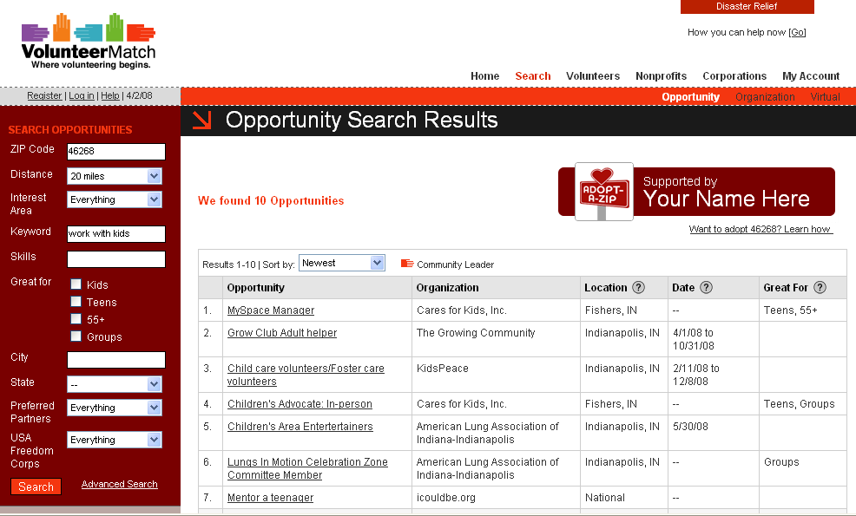
Service project ideas www.volunteermatch.org
Research service opportunities in your community.

Slide 13
Questions? Need to order materials?
Kiwanis-family Member Services
800-KIWANIS or 317-828-8775
Extension 411

